Slide 1
SAP UI5/Fiori

Slide 2
CONTENTS
SAP UI5 & Fiori Overview
Development Environment & First UI5 App
MVC Architecture & Controllers
Data Binding & Models
UI Controls, Layouts & Tables
Routing & Navigation
Odata Model Integration
CRUD Operations
Filters, Search & Value Help
Error Handling & Debugging
Fiori Launchpad & Deployment
Best Practices

Slide 3
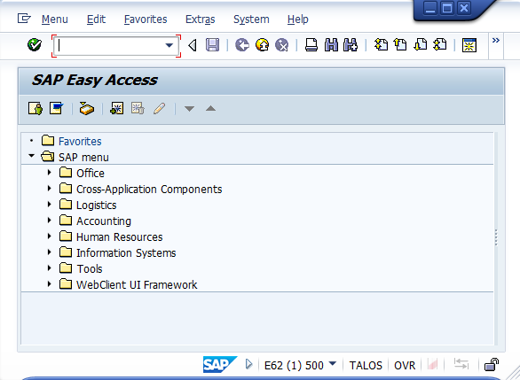
Sap gui
Desktop based
Transaction heavy
Not user friendly
Non - responsive

Slide 4
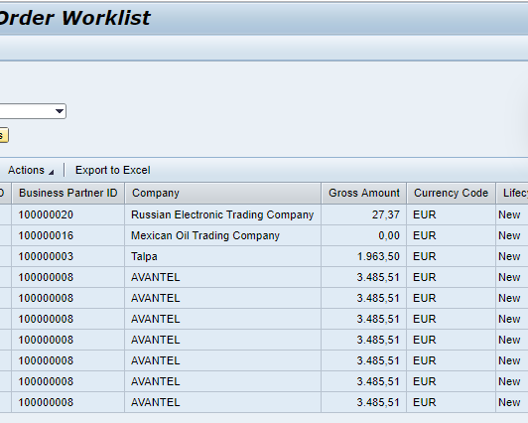
Web Dynpro
Server Side Rendering
Tight Coupling with Backend
Slow UI changes
Limited UX flexibility

Slide 5
Why sap changed direction ?
Need for :
Browser based apps
Mobile Responsiveness
Faster UI Development
Better user experience

Slide 6
Sap Ui5
A JS based UI framework provided by SAP for building web apps.
Core characteristics :
Client –side rendering.
Runs in the browser
Based on HTML5, CSS and JavaScript
Rich set of reusable UI Controls

Slide 7
Key building blocks
MVC Architecture
Views (XML)
Controllers (JS)
Models & Data Binding
UI Controls

Slide 8
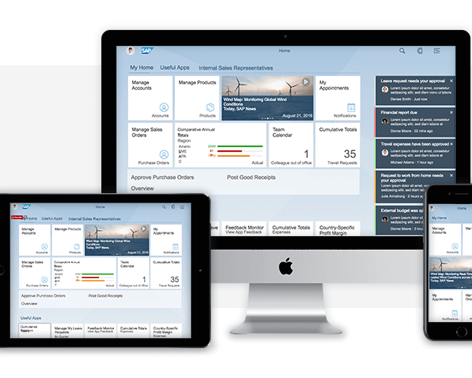
What is sap fiori?
Modern, role-based UX for SAP
Runs on Web browser
Works on all devices
Based on SAP UI5 framework

Slide 9
Sap Fiori design principles
Role Based
Simple
Responsive
Coherent
Delightful

Slide 10
Types of sap Fiori apps
Freestyle SAP UI5 Apps :
Full UI control
XML + JS
More development effort
Used for complex UI requirements
Fiori Elements Apps
Metadata – driven UI
Based on CDS annotations
Faster development
Less UI customization

Slide 11
Development tools
SAP Business Application Studio – Cloud based IDE
Web IDE
VS Code

Slide 12
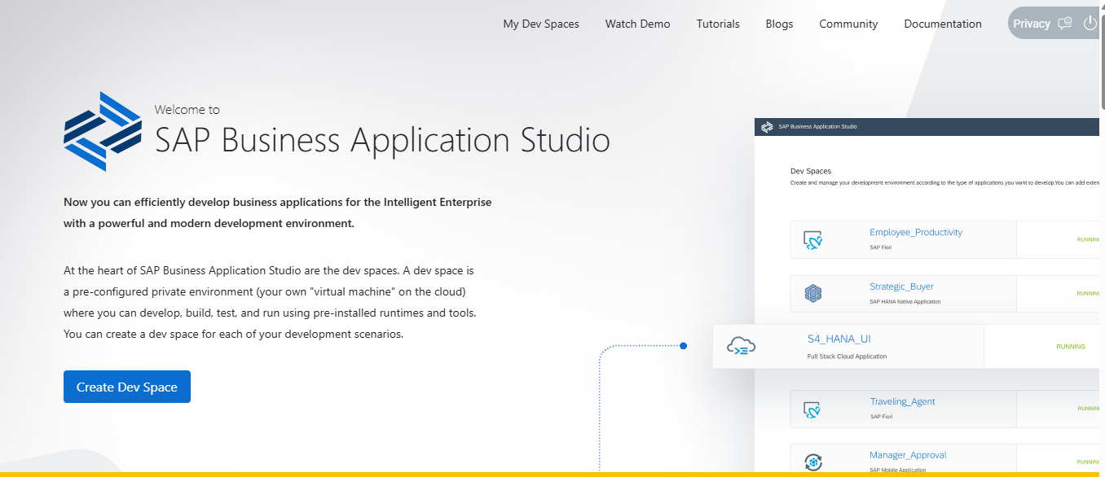
Sap BAS
Browser based development environment
Private Virtual Machine in Cloud
VS Code Compatible Experience
Optimized for :
SAP UI5
Fiori
CAP
SAP BTP Development

Slide 13
Creation of a project

Slide 14
Project structure
Controller : JavaScript logic for each view
View : XML Views
CSS : CSS files for styling
index.html : Bootstraps SAPUI5 and launches the app
Manifest.json : App configuration (routing, models, services)
Component.js : Initializes the app, loads views and models (App entry point)

Slide 15
Visual Flow
index.html
↓
UI5 Bootstrap
↓
ComponentSupport
↓
Component.js
↓
manifest.json
↓
Root View
↓
App UI

Slide 16
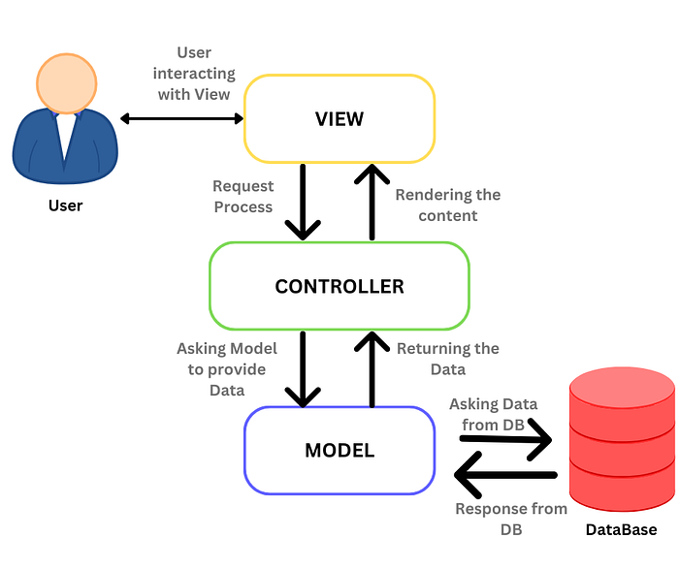
MVC Architecture
Model – Data (JSON/ OData)
View – UI (XML)
Controller – Logic (JS)

Slide 17
Types of views
XML View
JS View
HTML View

Slide 18
XML Views
XML : A declarative way to describe UI.
Why XML ?
Clean
Readable
Easy for designers and developers
SAP tooling supports it heavily

Slide 19
Controller
Controller defines what happens
Lifecycle methods :
onInit()
onBeforeRendering()
onAfterRedning()
onExit()

Slide 20
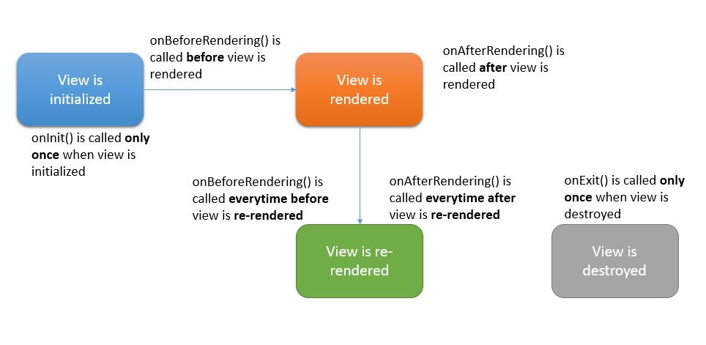

Slide 21
Models
A Model is a container that holds data for the application.
Models in UI5 :
JSON Model
Odata Model
XML Model
Resource Model

Slide 22
DATA BINDING
Data Binding is a connection between the UI and a data source.
Types of Data Binding :
Property Binding
Aggregation Binding
Element Binding
Expression Binding
Binding Modes :
One Way
Two Way
One Time

Slide 23
formatters
Model stores raw data, formatter makes it human-readable.

Slide 24
CONTROLS
Button
HBox
VBox
SimpleForm
Table

Slide 25
ROUTING
If you don’t use routing:
You manually hide/show views
You load views dynamically
You lose browser history
Back button breaks
In UI5, routing connects URLs to Views.

